Slide 1
Eye Tracking in 5G Era
Develop Beyond 2019​
Pravin Kumar Rana and Gérald Bianchi
17 September 2019

Slide 2
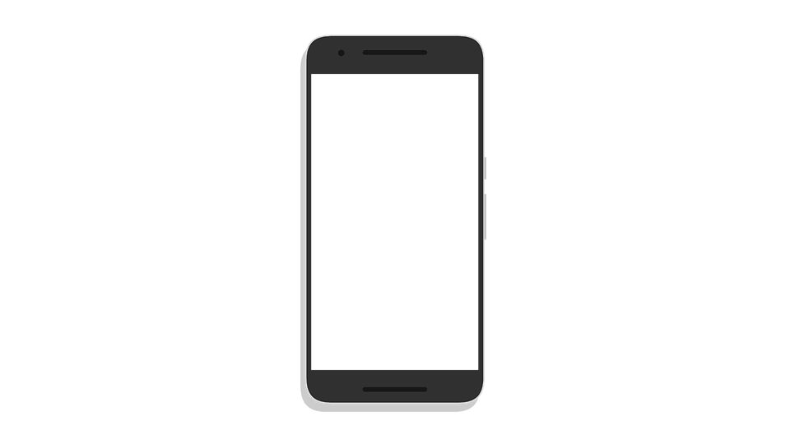
Source: Googling
Smart mobile phone (2019)

Slide 3
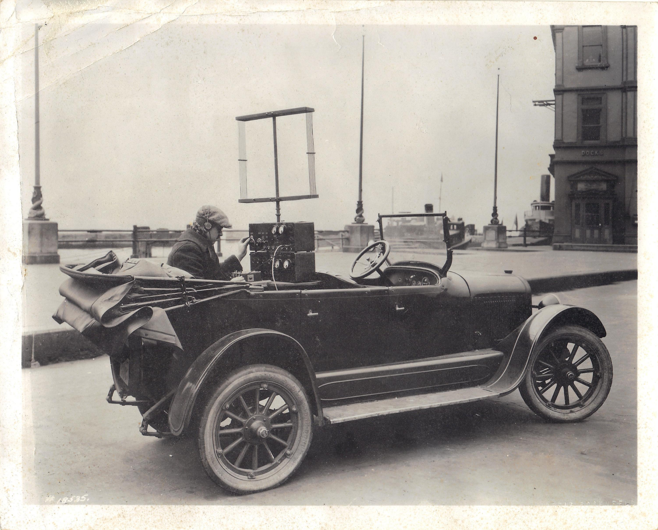
Source: Googling
Bell Lab Two-way Radio Mobile Telephone (1924)
Notes:
https://imgur.com/gallery/Vjn5b7Z

Slide 4
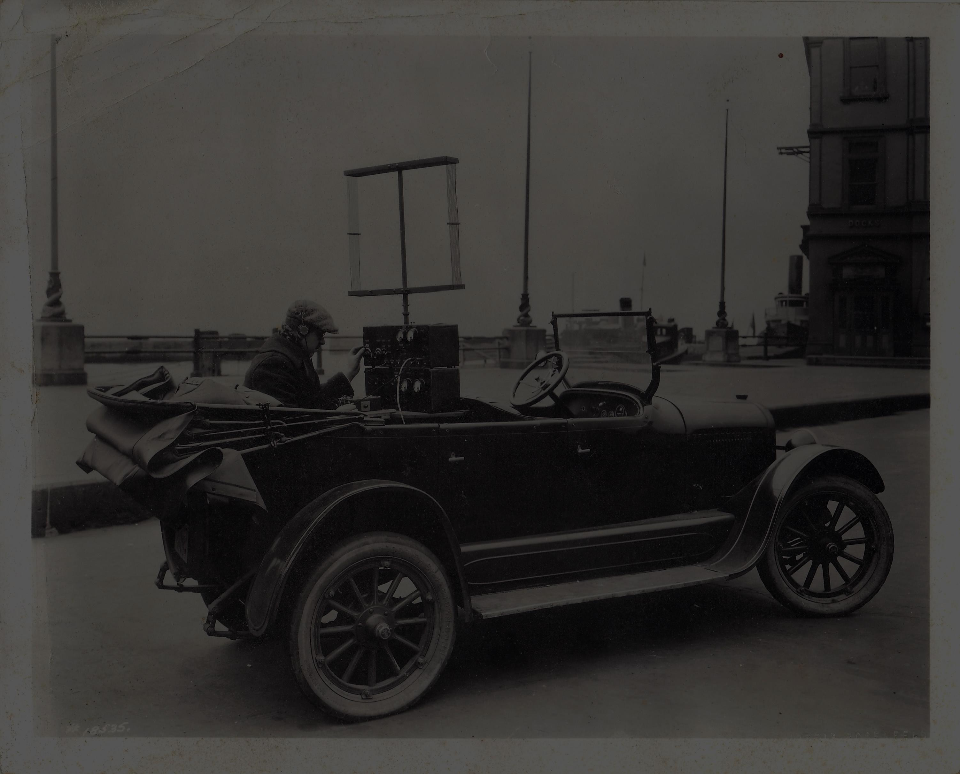
Source: Googling
Bell Lab Two-way Radio Mobile Telephone (1924)
Notes:
https://imgur.com/gallery/Vjn5b7Z

Slide 5
Evolution of Technology and Wireless Telecommunication Standards
Notes:
What is mobile network and history
0G: Pre-cellular - Analog Radio telephone
1G: Mobile voice calls
2G: Mobile voice calls and SMS
3G: Mobile web browsing
4G: Mobile video consumption and higher data speed
5G: Technology to serve consumers and digitalization of industries.

Slide 6
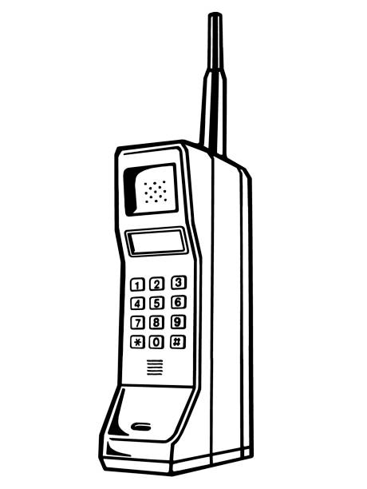


Evolution of Technology and Wireless Telecommunication Standards
0G
1946
1G
1979
Source: Ericsson
Notes:
What is mobile network and history
0G: Pre-cellular - Analog Radio telephone
1G: Mobile voice calls
2G: Mobile voice calls and SMS
3G: Mobile web browsing
4G: Mobile video consumption and higher data speed
5G: Technology to serve consumers and digitalization of industries.

Slide 7



Evolution of Technology and Wireless Telecommunication Standards
0G
1946
1G
1979
2G
1991
Source: Ericsson
Notes:
What is mobile network and history
0G: Pre-cellular - Analog Radio telephone
1G: Mobile voice calls
2G: Mobile voice calls and SMS
3G: Mobile web browsing
4G: Mobile video consumption and higher data speed
5G: Technology to serve consumers and digitalization of industries.

Slide 8


Evolution of Technology and Wireless Telecommunication Standards
0G
1946
1G
1979
2G
1991
3G
2001
Source: Ericsson
Notes:
What is mobile network and history
0G: Pre-cellular - Analog Radio telephone
1G: Mobile voice calls
2G: Mobile voice calls and SMS
3G: Mobile web browsing
4G: Mobile video consumption and higher data speed
5G: Technology to serve consumers and digitalization of industries.

Slide 9



Evolution of Technology and Wireless Telecommunication Standards
0G
1946
1G
1979
2G
1991
3G
2001
4G
2009
Source: Ericsson
Notes:
What is mobile network and history
0G: Pre-cellular - Analog Radio telephone
1G: Mobile voice calls
2G: Mobile voice calls and SMS
3G: Mobile web browsing
4G: Mobile video consumption and higher data speed
5G: Technology to serve consumers and digitalization of industries.

Slide 10
Evolution of Technology and Wireless Telecommunication Standards
0G
1946
1G
1979
2G
1991
3G
2001
4G
2009
5G
2020...
Source: Ericsson
Notes:
What is mobile network and history
0G: Pre-cellular - Analog Radio telephone
1G: Mobile voice calls
2G: Mobile voice calls and SMS
3G: Mobile web browsing
4G: Mobile video consumption and higher data speed
5G: Technology to serve consumers and digitalization of industries.

Slide 11
What is 5G?
It is next generation wireless telecommunication technology ​standards
Source: Ericsson
Notes:
What is 5g and why it is important
The fifth generation networks (5G) is currently under development and will hit the market at the horizon 2020.
Previous generations of mobile networks addressed consumers predominantly for voice and SMS in 2G, web-browsing in 3G and higher-speed data and video streaming in 4G.
The transition from 4G to 5G will serve both consumers and multiple industries. With global mobile data traffic expected to grow eight times by the end of 2023, there is a need for a more efficient technology, higher data rates and spectrum utilization. New applications such as 4K/8K video streaming, virtual and augmented reality and emerging industrial use cases will also require higher bandwidth, greater capacity, security, and lower latency. Equipped with these capabilities, 5G will bring new opportunities for people, society, and businesses.

Slide 12
What is 5G?
High
Bandwidth
(Up to 1000x)
It is next generation wireless telecommunication technology ​standards
Up to
10x - 100x
Data Rates
(1 - 20 Gbps)
Source: Ericsson
Notes:
What is 5g and why it is important
The fifth generation networks (5G) is currently under development and will hit the market at the horizon 2020.
Previous generations of mobile networks addressed consumers predominantly for voice and SMS in 2G, web-browsing in 3G and higher-speed data and video streaming in 4G.
The transition from 4G to 5G will serve both consumers and multiple industries. With global mobile data traffic expected to grow eight times by the end of 2023, there is a need for a more efficient technology, higher data rates and spectrum utilization. New applications such as 4K/8K video streaming, virtual and augmented reality and emerging industrial use cases will also require higher bandwidth, greater capacity, security, and lower latency. Equipped with these capabilities, 5G will bring new opportunities for people, society, and businesses.

Slide 13
What is 5G?
High
Bandwidth
(Up to 1000x)
It is next generation wireless telecommunication technology ​standards
Up to
10x - 100x
Data Rates
(1 - 20 Gbps)
Ultra-Low
Latency
(1 - 10 ms)
High Reliability
(99.999 %)
Source: Ericsson
Notes:
What is 5g and why it is important
The fifth generation networks (5G) is currently under development and will hit the market at the horizon 2020.
Previous generations of mobile networks addressed consumers predominantly for voice and SMS in 2G, web-browsing in 3G and higher-speed data and video streaming in 4G.
The transition from 4G to 5G will serve both consumers and multiple industries. With global mobile data traffic expected to grow eight times by the end of 2023, there is a need for a more efficient technology, higher data rates and spectrum utilization. New applications such as 4K/8K video streaming, virtual and augmented reality and emerging industrial use cases will also require higher bandwidth, greater capacity, security, and lower latency. Equipped with these capabilities, 5G will bring new opportunities for people, society, and businesses.

Slide 14
What is 5G?
​High
Bandwidth
(Up to 1000x)
It is next generation wireless telecommunication technology ​standards
Up to
10x - 100x
Connected
Devices
Up to
10x - 100x
Data Rates
(1 - 20 Gbps)
Ultra-Low
Latency
(1 - 10 ms)
High Reliability
(99.999 %)
Source: Ericsson
Notes:
What is 5g and why it is important
The fifth generation networks (5G) is currently under development and will hit the market at the horizon 2020.
Previous generations of mobile networks addressed consumers predominantly for voice and SMS in 2G, web-browsing in 3G and higher-speed data and video streaming in 4G.
The transition from 4G to 5G will serve both consumers and multiple industries. With global mobile data traffic expected to grow eight times by the end of 2023, there is a need for a more efficient technology, higher data rates and spectrum utilization. New applications such as 4K/8K video streaming, virtual and augmented reality and emerging industrial use cases will also require higher bandwidth, greater capacity, security, and lower latency. Equipped with these capabilities, 5G will bring new opportunities for people, society, and businesses.

Slide 15
What is 5G?
High
Bandwidth
(Up to 1000x)
It is next generation wireless telecommunication technology ​standards
Up to
10x - 100x
Connected
Devices
Up to
10x - 100x
Data Rates
(1 - 20 Gbps)
Ultra-Low
Latency
(1 - 10 ms)
Up to 90%
Power
Efficient
Devices and
Networks
High Reliability
(99.999 %)
Source: Ericsson
Notes:
What is 5g and why it is important
The fifth generation networks (5G) is currently under development and will hit the market at the horizon 2020.
Previous generations of mobile networks addressed consumers predominantly for voice and SMS in 2G, web-browsing in 3G and higher-speed data and video streaming in 4G.
The transition from 4G to 5G will serve both consumers and multiple industries. With global mobile data traffic expected to grow eight times by the end of 2023, there is a need for a more efficient technology, higher data rates and spectrum utilization. New applications such as 4K/8K video streaming, virtual and augmented reality and emerging industrial use cases will also require higher bandwidth, greater capacity, security, and lower latency. Equipped with these capabilities, 5G will bring new opportunities for people, society, and businesses.

Slide 16



What is 5G?
High
Bandwidth
(Up to 1000x)
It is next generation wireless telecommunication technology ​standards
Up to
10x - 100x
Connected
Devices
Up to
10x - 100x
Data Rates
(1 - 20 Gbps)
Ultra-Low
Latency
(1 - 10 ms)
Up to 90%
Power
Efficient
Devices and
Networks
High Reliability
(99.999 %)
With 5G, we are creating the
biggest innovation platform ever.
Source: Ericsson
Notes:
What is 5g and why it is important
The fifth generation networks (5G) is currently under development and will hit the market at the horizon 2020.
Previous generations of mobile networks addressed consumers predominantly for voice and SMS in 2G, web-browsing in 3G and higher-speed data and video streaming in 4G.
The transition from 4G to 5G will serve both consumers and multiple industries. With global mobile data traffic expected to grow eight times by the end of 2023, there is a need for a more efficient technology, higher data rates and spectrum utilization. New applications such as 4K/8K video streaming, virtual and augmented reality and emerging industrial use cases will also require higher bandwidth, greater capacity, security, and lower latency. Equipped with these capabilities, 5G will bring new opportunities for people, society, and businesses.

Slide 17












Quotes
AR and VR: The First Wave of 5G
Killer Apps
Why Doctors and Gamers Are Equally Excited for 5G’s Launch
I played Shadow of the Tomb Raider over 5G, and it didn't suck
5G will transform key industries such as autonomous vehicles, aviation, and healthcare
By removing complex and expensive elements from devices, their form factors can be transformed
completely, with the only limits being the imagination
of designers

Slide 18



The 4th Industrial Revolution
1st Industrial Revolution
2nd Industrial Revolution
3rd Industrial Revolution
4th Industrial Revolution
Intelligence-based
Business
Internet-based
Business
Energy-based
Mass Production
WWW
Steam-based
Machines
Source: Ericsson

Slide 19
Motivations - 5G Driven Technology
Notes:
Light and cheap form factors
Energy effiency
https://www.cbinsights.com/research/edge-computing-ecosystem/
Automotive: electric cars – low power consumption
TobiiDynavox: cheaper devices

Slide 20
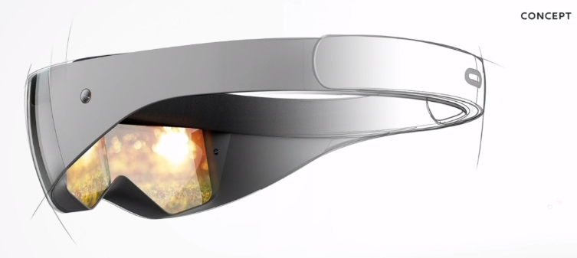
Motivations - 5G Driven Technology
Small and light form factors
Courtesy of Facebook Oculus
Notes:
Enabled by 5G by offloading heavy data processing onto the cloud.

Slide 21
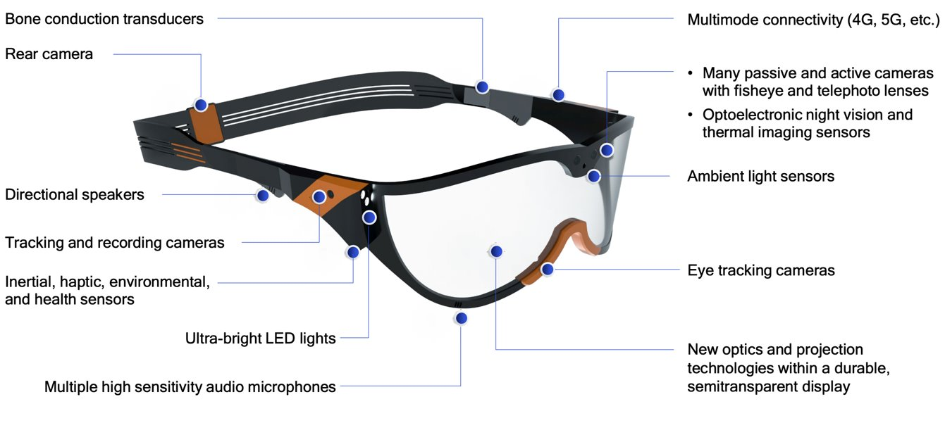
Motivations - 5G Driven Technology
Small and light form factors
Courtesy of Facebook Oculus
Multiple sensors
Courtesy of Qualcomm
Notes:
Enabled by 5G by offloading heavy data processing onto the cloud.

Slide 22
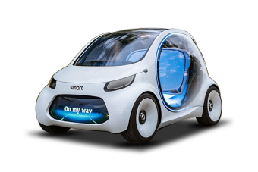
Motivations - 5G Driven Technology
Small and light form factors
Courtesy of Facebook Oculus
Multiple sensors
Energy efficiency
Courtesy of Qualcomm
Courtesy of Mercedes-Benz
Notes:
Enabled by 5G by offloading heavy data processing onto the cloud.

Slide 23
Motivations - 5G Driven Technology
Small and light form factors
Low price point
Courtesy of Facebook Oculus
Multiple sensors
Energy efficiency
Courtesy of Qualcomm
Courtesy of Mercedes-Benz
Notes:
Enabled by 5G by offloading heavy data processing onto the cloud.

Slide 24
Motivations - 5G Driven Technology
Small and light form factors
Low price point
Courtesy of Facebook Oculus
Multiple sensors
ENABLED BY 5G
Energy efficiency
Courtesy of Qualcomm
Courtesy of Mercedes-Benz
Notes:
Enabled by 5G by offloading heavy data processing onto the cloud.
For example, the XR industry already think of moving the 3D rendering to the cloud and send the rendered images to the HMD through 5G.
This way, the user will not need to acquire an expensive computer with a powerful graphics card. Everyone will be able to enjoy XR experience.

Slide 25
What 5G Can Bring to Eye Tracking
Notes:
High device density -
Low latency -
High data rate -
Low power consumption -
Turn Eye Tracking to a service – any user can subscribe to our ET cloud service

Slide 26
What 5G Can Bring to Eye Tracking
Light form factors
Notes:
In the future, hardware will shrink to become small and lighter so ET hardware will need to follow that trend.
By offloading heavy ET processing into the cloud, enable us to reach more devices (e.g less illuminators, smaller or no EyeChip, )

Slide 27
What 5G Can Bring to Eye Tracking
Light form factors
Access to Wide Spectrum of Sensors
Notes:
Eye tracking can be done not only with NIR camera sensor but also RGB camera sensors, depth sensors, ...

Slide 28
What 5G Can Bring to Eye Tracking
Light form factors
Access to Wide Spectrum of Sensors
Low
Integration
Cost
and Time
Notes:
Access to existing sensors, so no need to integrate those sensors ourselves.

Slide 29
What 5G Can Bring to Eye Tracking
Light form factors
Access to Wide Spectrum of Sensors
Low
Integration
Cost
and Time
Faster
Deployment and
Development
Notes:
Thanks to 5G, we will be able to develop and deploy ET solution for any devices that support use facing sensor.

Slide 30





What 5G Can Bring to Eye Tracking
Light form factors
Access to Wide Spectrum of Sensors
Low
Integration
Cost
and Time
Faster
Deployment and
Development
Eye Tracking
for
Everyone
Notes:
The user will only need to connect to our cloud service to enable eye tracking on her existing hardware. Eye tracking becomes a service for everyone.
High device density -
Low latency -
High data rate -
Low power consumption -
Turn Eye Tracking to a service – any user can subscribe to our ET cloud service

Slide 31







5G Eye Tracking Ecosystem
Sensors

Slide 32

5G Eye Tracking Ecosystem
Sensors
Universal Eye Tracking Standards
(UETS)
Interface and specifications to facilitate eye tracking across different sensors

Slide 33

5G Eye Tracking Ecosystem
Sensors
Edge Computing
Universal Eye Tracking Standards
(UETS)
Interface and specifications to facilitate eye tracking across different sensors
Extract higher-level representation of eye features
Identify sensing system

Slide 34


5G Eye Tracking Ecosystem
Sensors
Cloud Computing
Edge Computing
Universal Eye Tracking Standards
(UETS)
Interface and specifications to facilitate eye tracking across different sensors
Extract higher-level representation of eye features
Identify sensing system
Heavier eye tracking algorithms
Act as interface to services, such as AWARE
Notes:
Example: Standards OpenXR

Slide 35
Values ...
Notes:
Affordable subscription: spectrum of services from example rough gaze to precise gaze

Slide 36
Values ...
Affordable
Subscription
for
Everyone
Notes:
We can collect large amount of data from gaze data, attention data, to user engagement, user adoption.

Slide 37
Values ...
Affordable
Subscription
for
Everyone
Better Customer Support
Notes:
We can collect large amount of data from gaze data, attention data, to user engagement, user adoption.

Slide 38
Values ...
Affordable
Subscription
for
Everyone
Big Data
Analytics
Better Customer Support
Notes:
We can collect large amount of data from gaze data, attention data, to user engagement, user adoption.

Slide 39
Challenges
To design a 5G eye tracking ecosystem
Notes:
Scalability – Algorithms that can provide gaze from several different type of sensors
Provide gaze from several different type of sensors (NIR, RGB, w/wo glints, not sensitive to image resolutions, sensor fusion, single and multi-sepctral images...)
User calibration
Common eye representation
Test the 5G network latency
Design new framework for algorithms (for example: IS5 pro and AR-ETYPE-3 split algobox on several EyeChips)
Design new cloud algorithms to detect ET system/camera (RGB/IR)

Slide 40
Challenges
Scalable
Platform
Support different sensors
Enable wide use cases
Scale-up with demand
To design a 5G eye tracking ecosystem
Notes:
Scalability – Algorithms that can provide gaze from several different type of sensors
Provide gaze from several different type of sensors (NIR, RGB, w/wo glints, not sensitive to image resolutions, sensor fusion, single and multi-sepctral images...)
User calibration
Common eye representation
Test the 5G network latency
Design new framework for algorithms (for example: IS5 pro and AR-ETYPE-3 split algobox on several EyeChips)
Design new cloud algorithms to detect ET system/camera (RGB/IR)

Slide 41
Challenges
Scalable
Platform
Support different sensors
Enable wide use cases
Scale-up with demand
To design a 5G eye tracking ecosystem
Smart
Platform
Identify device environment
Select services intelligently
Manage resources efficiently
Notes:
Scalability – Algorithms that can provide gaze from several different type of sensors
Provide gaze from several different type of sensors (NIR, RGB, w/wo glints, not sensitive to image resolutions, sensor fusion, single and multi-sepctral images...)
User calibration
Common eye representation
Test the 5G network latency
Design new framework for algorithms (for example: IS5 pro and AR-ETYPE-3 split algobox on several EyeChips)
Design new cloud algorithms to detect ET system/camera (RGB/IR)

Slide 42
Challenges
Scalable
Platform
Support different sensors
Enable wide use cases
Scale-up with demand
To design a 5G eye tracking ecosystem
Smart
Platform
Identify device environment
Select services intelligently
Manage resources efficiently
Resilient
Platform
Robust services, e.g.: detect and correct gaze losses
Notes:
Scalability – Algorithms that can provide gaze from several different type of sensors
Provide gaze from several different type of sensors (NIR, RGB, w/wo glints, not sensitive to image resolutions, sensor fusion, single and multi-sepctral images...)
User calibration
Common eye representation
Test the 5G network latency
Design new framework for algorithms (for example: IS5 pro and AR-ETYPE-3 split algobox on several EyeChips)
Design new cloud algorithms to detect ET system/camera (RGB/IR)

Slide 43
Challenges
Scalable
Platform
Support different sensors
Enable wide use cases
Scale-up with demand
To design a 5G eye tracking ecosystem
Smart
Platform
Identify device environment
Select services intelligently
Manage resources efficiently
Ecosystem Standards
Resilient
Platform
Interoperability between devices and services
Robust services, e.g.: detect and correct gaze losses
Notes:
Scalability – Algorithms that can provide gaze from several different type of sensors
Provide gaze from several different type of sensors (NIR, RGB, w/wo glints, not sensitive to image resolutions, sensor fusion, single and multi-sepctral images...)
User calibration
Common eye representation
Test the 5G network latency
Design new framework for algorithms (for example: IS5 pro and AR-ETYPE-3 split algobox on several EyeChips)
Design new cloud algorithms to detect ET system/camera (RGB/IR)

Slide 44
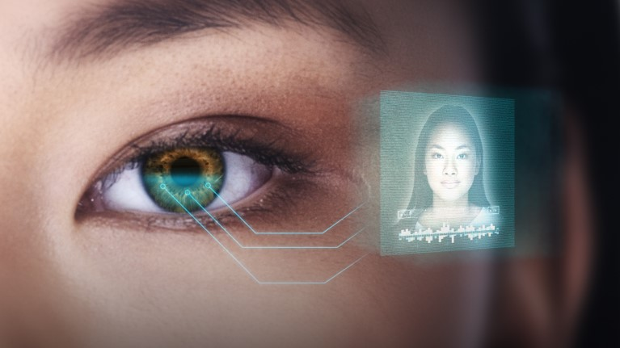
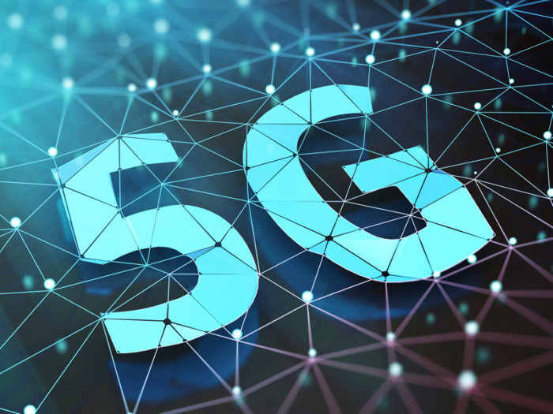
Let's keep an eye on the future of eye tracking with 5G

Slide 45
Thank you for listening

